Slide 1

Real Estate Project

Slide 2




Project Overview
This project collects real-time data from the Azerbaijani real estate market, stores it in a structured format, builds a Data Warehouse (DWH) for analytical processing, generates price predictions using machine learning, and provides interactive dashboards.
Data Collection
Data Warehousing
Automated gathering of real-time real estate data.
Structured storage and management for analytical processing.
ML Predictions
Interactive Dashboards
Machine learning models for accurate price forecasting.
Visualizing insights for market trends and predictions.

Slide 3
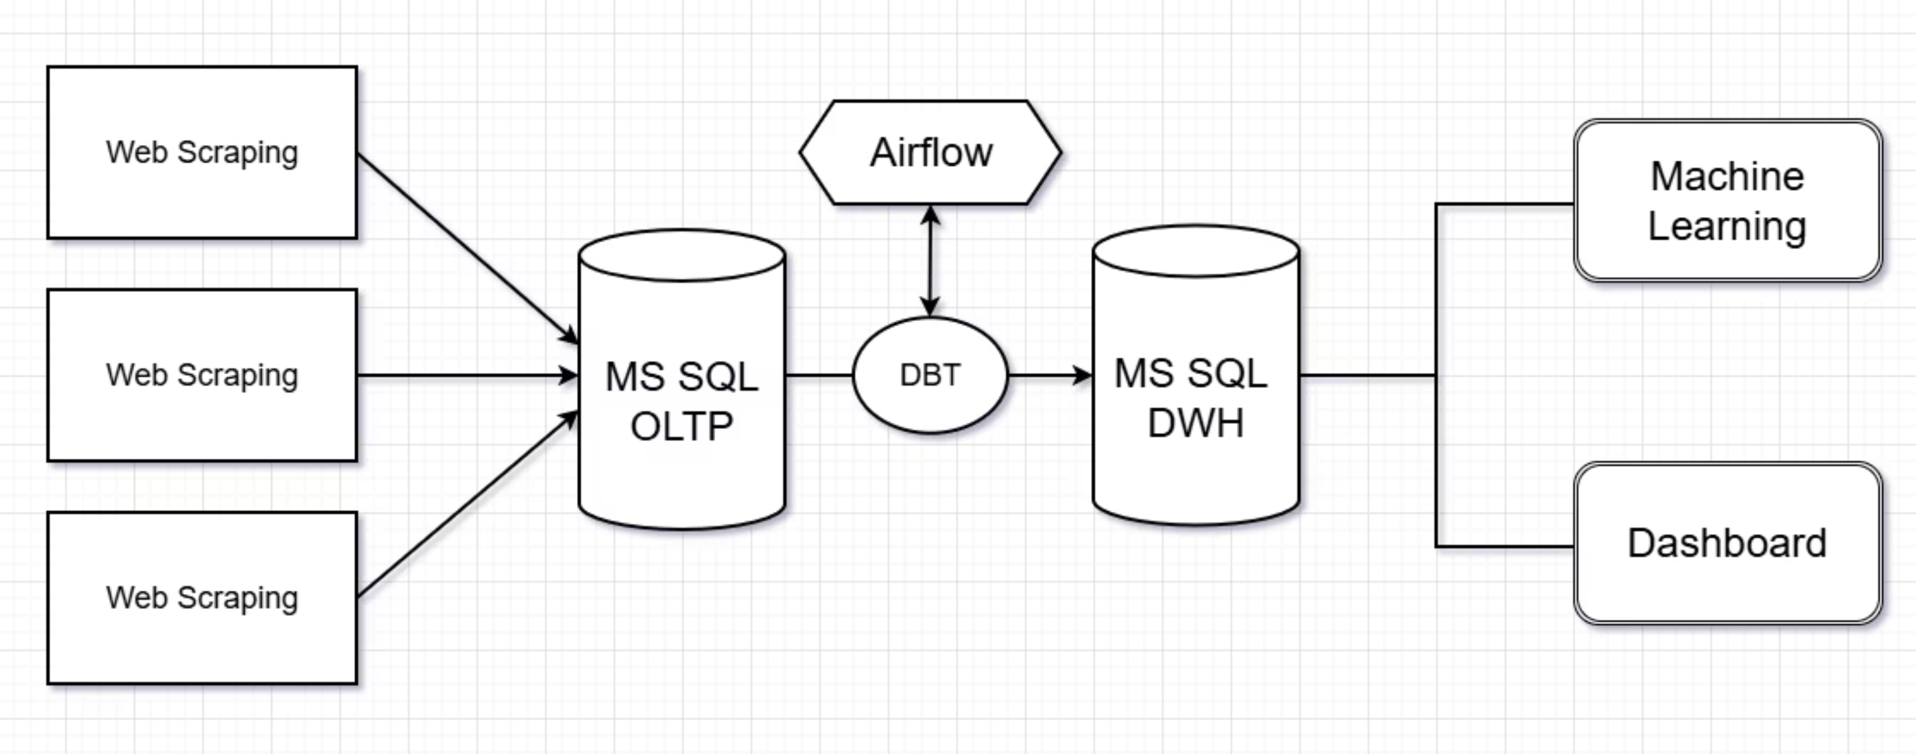
Architecture

Slide 4





Data Pipeline Flow
Our robust data pipeline ensures a seamless flow from raw data acquisition to insightful analytics.
Web Scraping (Python)
Automated extraction of real estate data from various web sources using Python scripts.
MS SQL OLTP
Initial storage of raw and operational data in the transactional database.
DBT ETL + Airflow
Data transformation and loading into the Data Warehouse using DBT.
Data Warehouse
Structured layers (STG → CORE → DM) for optimized analytical queries.
ML Model & Power BI
Utilizing processed data for machine learning predictions and interactive dashboards.

Slide 5
Project Objectives
1
Automated Data Collection
2
Data Storage & Management
Implementing robust web scraping from diverse online sources to capture real-time real estate listings and market data, ensuring comprehensive coverage and freshness of information.
Storing and managing collected data in an MS SQL OLTP database, ensuring transactional integrity and efficient handling of both volatile operational data (apartments, houses) and stable referential data (cities, metro stations).
3
ETL Process with DBT
4
ML Price Prediction & Visualization
Leveraging DBT (Data Build Tool) for efficient ETL processes, transforming raw data into a structured Data Warehouse, optimizing for analytical queries and reporting.
Developing and deploying machine learning models for accurate real estate price forecasting, with results visually presented through interactive Power BI dashboards for clear market insights.

Slide 6


Data Architecture: OLTP & DWH
OLTP (Operational Store)
DWH (Analytical Store)
The Operational Store is an MS SQL database designed for initial ingestion of web scraping results and storage of both operational (e.g., Apartment, House, Office details) and referential (e.g., City, Metro, SalesType information) data. It ensures data integrity and supports real-time transactions.
The Data Warehouse, built post-DBT ETL, features a three-layered structure optimized for analytical processing:
STG: Raw data cleaning and staging (stg\_* tables).
CORE: Core fact (fact\_*) and dimension (dim\_*) tables for consolidated data.
DM: Thematic data marts (dm\_*) tailored for specific analytical needs and reporting.

Slide 7



ML Model
Prediction Models
Performance Evaluation
RandomForest: An ensemble learning method for classification, regression and other tasks that operates by constructing a multitude of decision trees at training time and outputting the class that is the mode of the classes (classification) or mean prediction (regression) of the individual trees.
MAE (Mean Absolute Error): Measures the average magnitude of the errors in a set of forecasts, without considering their direction.
RMSE (Root Mean Squared Error): Measures the magnitude of the error, giving more weight to larger errors.
R² (R-squared): Represents the proportion of the variance in the dependent variable that is predictable from the independent variables.
XGBoost: An optimized distributed gradient boosting library designed to be highly efficient, flexible, and portable. It implements machine learning algorithms under the Gradient Boosting framework.
Visualization for Insights
Residual Distribution
Actual vs. Predicted
Feature Importance
A histogram to visualize the distribution of prediction errors, helping assess model bias.
A scatter plot showing the correlation between actual and predicted values, indicating model accuracy.
A bar chart illustrating the contribution of each feature to the prediction, highlighting key drivers.

Slide 8






Key Achievements
The project successfully delivered a robust data solution with significant capabilities.
Accurate Machine Learning Forecasts
Development and deployment of highly accurate machine learning models, providing reliable real estate price predictions to support informed decision-making.
OLTP/DWH Infrastructure
A meticulously designed and implemented database and data warehouse infrastructure, ensuring data integrity, scalability, and optimal performance for both operational and analytical needs.
Interactive Power BI Dashboards
Creation of intuitive and dynamic Power BI dashboards, offering comprehensive visualizations of market trends, prediction results, and key performance indicators for easy data exploration.

Slide 9
Thank you for your attention!

